Slide 1
Inventions
By Kaitlin

Slide 2
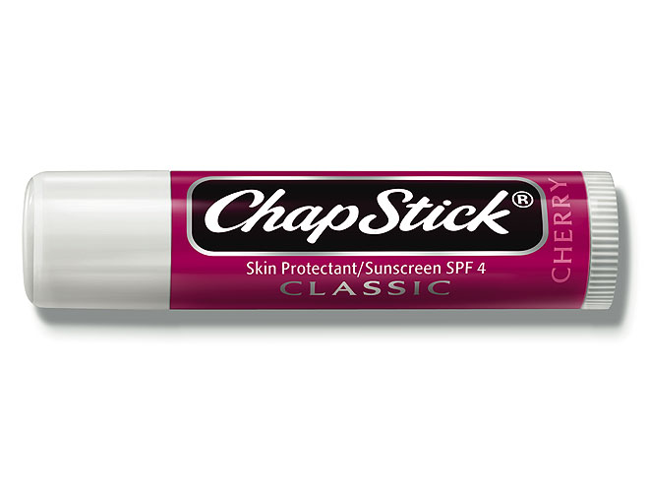
ChapStick
Common Invention

Slide 3
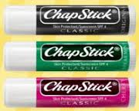
ChapStick
inventor and date invented | Dr. Charles Browne Fleet in the year 1880 and is still in use today
Invention Purpose | Used to relieve dry or chapped lips. May also be used to smooth them. People of all ages buy this
Cost | The price is about $2.00
Reason for inventing this | He invented this to combat dry cracked lips
Main components | Beeswax, sunscreen, petroleum jelly, lanolin

Slide 4
ChapStick
Challenges the inventor encountered | The inventor of ChapStick sold the product to John Morton because he failed to sell enough of it.
Similar Products | EOS, Burt’s Bees, Blistex

Slide 5
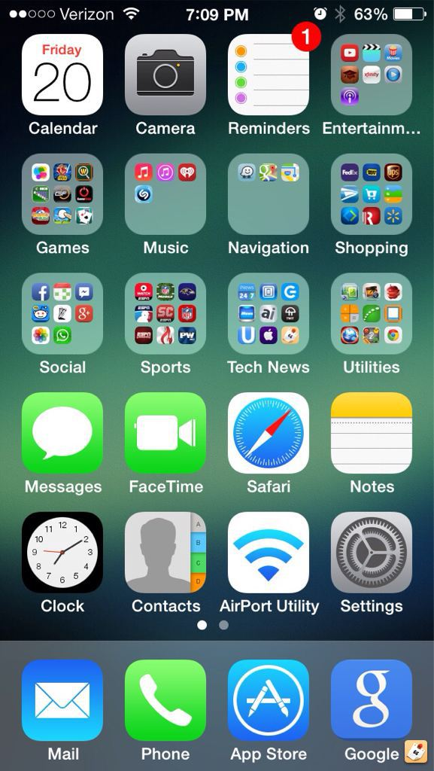
iPHONE
Technology Invention

Slide 6
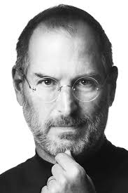
iPhone
Inventor and Date Invented | Steve Jobs in the year 2007 and is still in use today.
Inventions Purpose | used to communicate with people, remind you of tasks, entertain, take pictures, and to find information using the internet. People of all ages purchase this product.
Cost | Today the cost $649 to $749.
Reason for inventing this | They invented the iphone because they knew that someone was going to make a product better than their ipod so they needed to make something better.
Main Components | glass, stainless steel, and a battery

Slide 7
iPhone
Challenges the inventor faced | Other companies making better products People stealing their ideas
SImilar products | Samsung Galaxy LG HTC

Slide 8
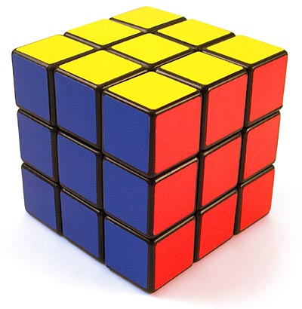
Rubik’s Cube
Entertainment Invention

Slide 9
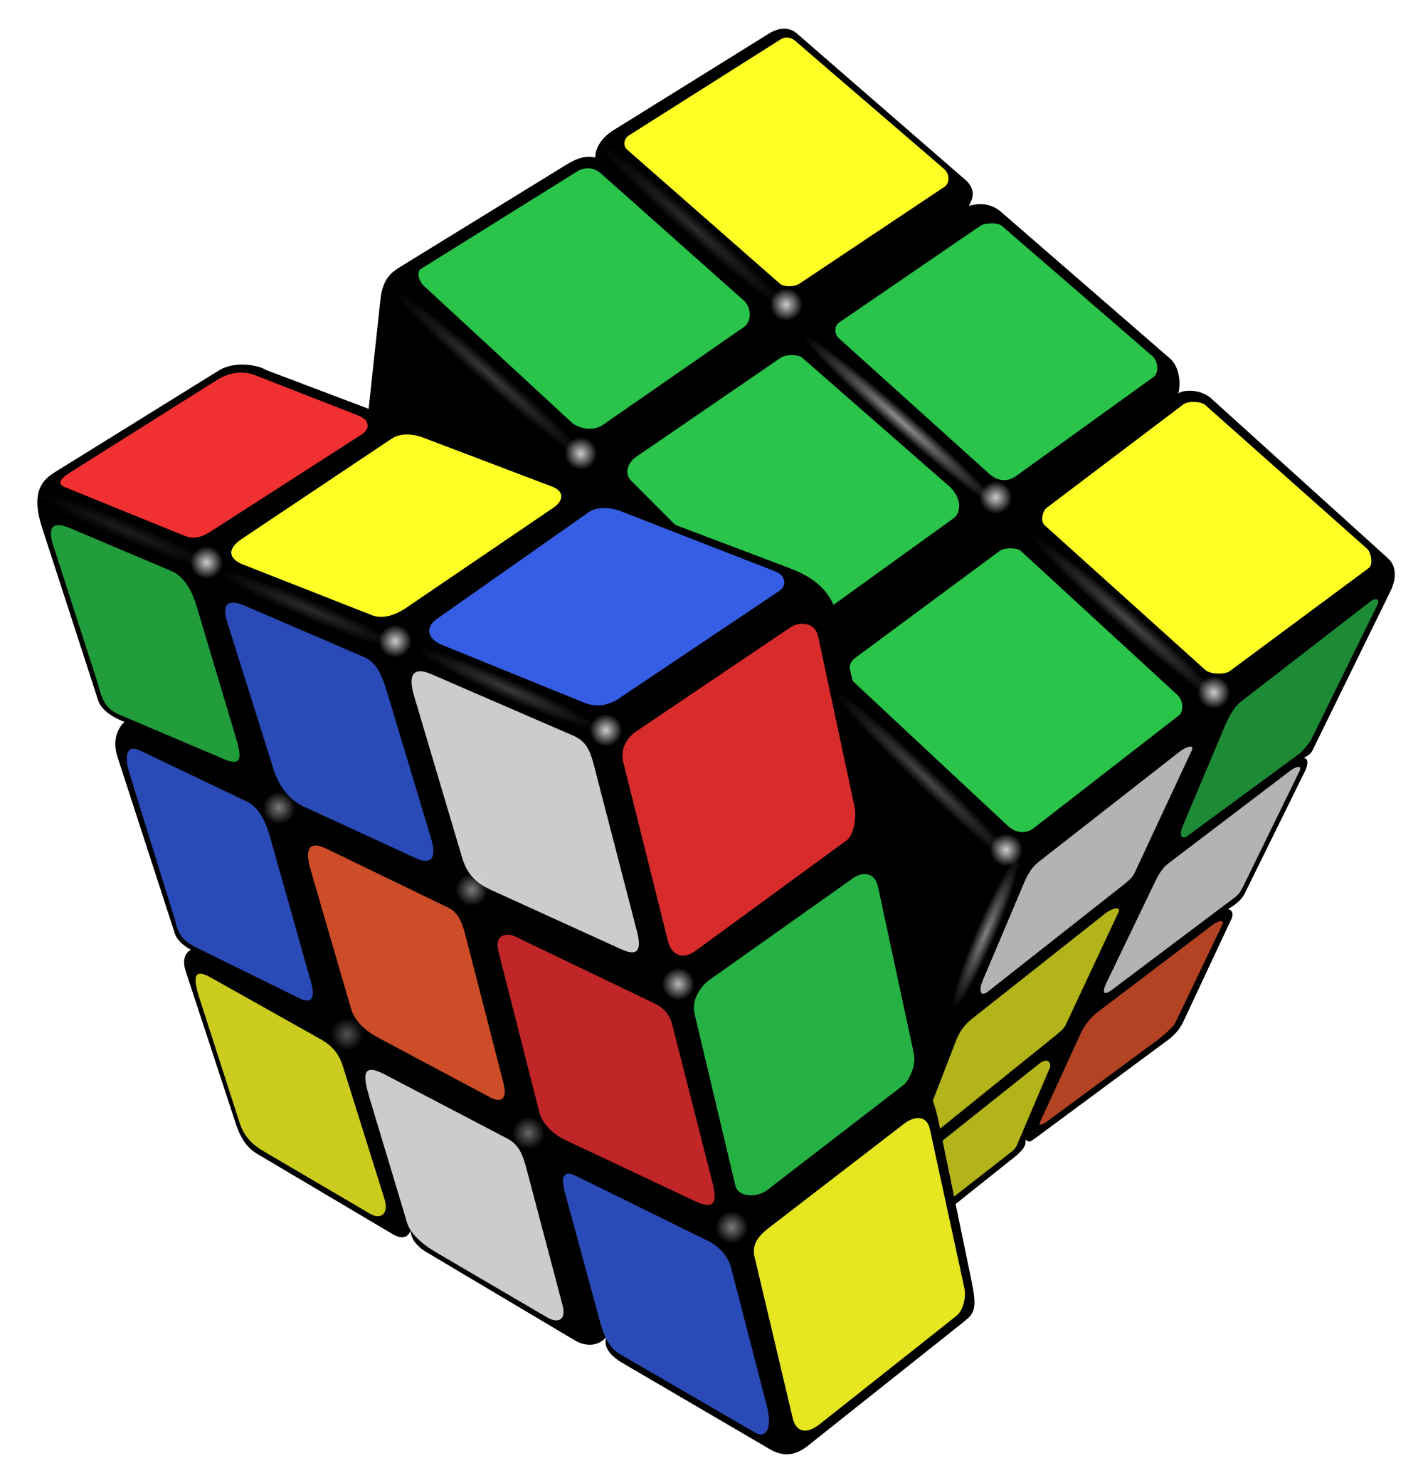
Rubik’s Cube
Inventor and date invented | Ernő Rubik invented the Rubik’s cube in the year 1974 and is still in use today.
invention’s Purpose | Used as a puzzle that is challenging to solve
Cost | $8.99
Reason for invention | Teacher who was looking for new and exciting ways to present information to his students; helped him to explain spatial relationships

Slide 10
Rubik’s cube
Main components | Plastic
Challenges the inventor faced | Selling the product was really hard in the beginning
Similar products | Puzzles Chess

Slide 11
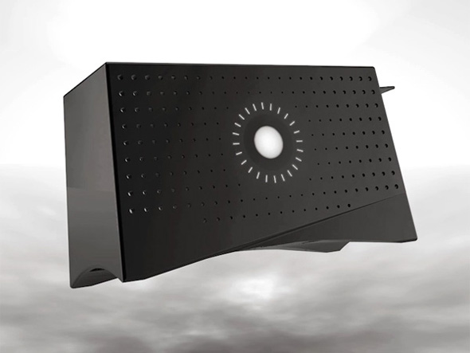
Hues Smart Toaster
Unusual invention

Slide 12
Hues smart toaster
Inventor and date invented | Invented by Basheer Tome in the year
Invention’s purpose | To perfectly toast bread to your preferred bread color.
Cost | Currently not released for purchase
Reason for invention | Wanted to create a toaster that would toast your bread perfectly. He was also tired of burnt toast.

Slide 13
Hues smart toaster
Main Components | Thermochromatic ink Nichrome wire Arduino color sensor metal
Challenges the inventor faced | His first few attempts were not successful
Similar products | toaster microwave oven

Slide 14
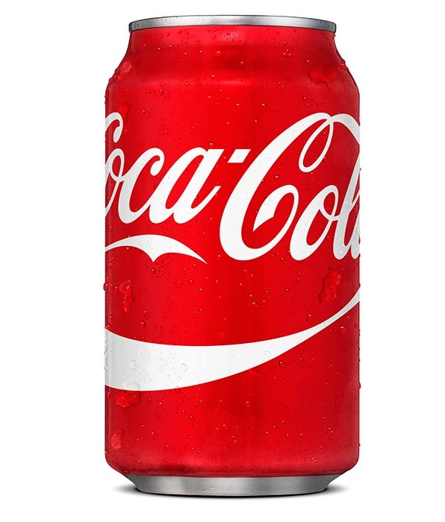
Coca-Cola
choice invention

Slide 15
Coca-Cola
Inventor and date invented | John Pemberton in the year 1886. This is still in use today
Invention’s purpose | It’s a beverage to drink and quench thirst.
Cost | $1.00 for a 12 oz can
Reason for invention | he wanted a drink that can be sold at soda fountains

Slide 16
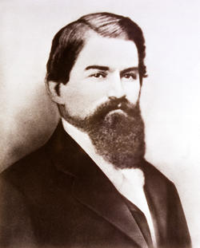
Main Components | High fructose corn syrup Caffeine Coca extract, Glycerin
Challenges the inventor faced
Similar products | Pepsi Dr Pepper

Slide 17
Resources
Pictures
http://forums.imore.com/iphone-5s/261887-show-us-your-iphone-5s-homescreen.html
http://funmozar.com/
http://www.cbfleet.com/about-us/
http://www.thinkgeek.com/product/69fe/
http://www.foodiggity.com/hue-a-toaster-that-can-be-programmed-by-color/
http://daily.jstor.org/the-coca-cola-wars-can-anybody-really-tell-the-difference/
http://thecube.guru/erno-rubik/
http://www.dailymail.co.uk/femail/article-2247038/No-burnt-toast-Student-21-invents-ingenious-toaster-comes-colour-chart--sense-bread-correct-shade-brown.html
http://www.coca-colacompany.com/stories/the-chronicle-of-coca-cola-birth-of-a-refreshing-idea/
http://www.businesshistory.com/ind._healthcare2.php
https://commons.wikimedia.org/wiki/File:Apple_logo_black.svg
http://www.retrothing.com/2008/02/the-secret-life.html
https://en.wikipedia.org/wiki/Rubik%27s_Cube

Slide 18
Resources
Information
http://www.coca-colacompany.com/stories/the-chronicle-of-coca-cola-birth-of-a-refreshing-idea/
https://www.rubiks.com/about/the-history-of-the-rubiks-cube
http://basheertome.com/hue/
http://www.chapstick.com/
http://www.madehow.com/Volume-7/Rubik-s-Cube.html
http://www.theevansgroupllc.com/published-articles/history-of-chapstick/

Slide 19
Kaitlin
Period 4

